Slide 1
Determinant
Hung-yi Lee
Notes:
Ref:
http://www.askamathematician.com/2013/05/q-why-are-determinants-defined-the-weird-way-they-are/

Slide 2
期中考
範圍：ch 1 ~ ch 4
時間：11/09 (五) 上課時間
地點：會公告在 ceiba 上

Slide 3
Reference
MIT OCW Linear Algebra:
Lecture 18: Properties of determinants
http://ocw.mit.edu/courses/mathematics/18-06-linear-algebra-spring-2010/video-lectures/lecture-18-properties-of-determinants/
Lecture 19: Determinant formulas and cofactors
http://ocw.mit.edu/courses/mathematics/18-06-linear-algebra-spring-2010/video-lectures/lecture-19-determinant-formulas-and-cofactors/
Lecture 20: Cramer's rule, inverse matrix, and volume
http://ocw.mit.edu/courses/mathematics/18-06-linear-algebra-spring-2010/video-lectures/lecture-20-cramers-rule-inverse-matrix-and-volume/
Textbook: Chapter 3
Notes:
Strang, Gilbert
In this course, we will use determinants will be used in Chapter 5 when we learn to calculate the eigenvalues of a square matrix (Chapter 5).

Slide 4
Determinant
The determinant of a square matrix is a scalar that provides information about the matrix.
E.g. Invertibility of the matrix.
Learning Target
The formula of Determinants
The properties of Determinants
Cramer’s Rule
Notes:
行列式
(Area and Volume)
The determinant is the “volume” in high dimension.
In this course, we will use determinants will be used in Chapter 5 when we learn to calculate the eigenvalues of a square matrix (Chapter 5).

Slide 5
Formula for Determinants
Notes:
Ref:
http://www.askamathematician.com/2013/05/q-why-are-determinants-defined-the-weird-way-they-are/

Slide 6





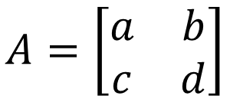







Determinants in High School
2 X 2
3 x 3
$$A=\left[\begin{matrix}a_{1} & a_{2} & a_{3} \\ a_{4} & a_{5} & a_{6} \\ a_{7} & a_{8} & a_{9}\end{matrix}\right]$$
$$A=\left[\begin{matrix}a & b \\ c & d\end{matrix}\right]$$
$$det\left(A\right)=$$
$$ad$$
$$−bc$$
$$det\left(A\right)=$$
$$a_{1}a_{5}a_{9}$$
$$+a_{2}a_{6}a_{7}$$
$$+a_{3}a_{4}a_{8}$$
$$\left[\begin{matrix}\begin{matrix}∗ & ∗ \\ ∗ & ∗\end{matrix} & \begin{matrix}∗ & ∗ \\ ∗ & ∗\end{matrix} \\ \begin{matrix}∗ & ∗ \\ ∗ & ∗\end{matrix} & \begin{matrix}∗ & ∗ \\ ∗ & ∗\end{matrix}\end{matrix}\right]$$
$$−a_{3}a_{5}a_{7}$$
$$−a_{2}a_{4}a_{9}$$
$$−a_{1}a_{6}a_{8}$$

Slide 7
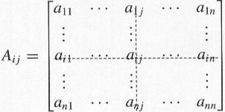
Cofactor Expansion
Suppose A is an n x n matrix. A_{ij} is defined as the submatrix of A obtained by removing the i-th row and the j-th column.
A
i-th row
J-th column

Slide 8

Cofactor Expansion
Pick row 1
Or pick row i
Or pick column j
$$detA=a_{11}c_{11}+a_{12}c_{12}+⋯+a_{1n}c_{1n}$$
c_{ij}: (i,j)-cofactor
$$detA=a_{i1}c_{i1}+a_{i2}c_{i2}+⋯+a_{in}c_{in}$$
$$detA=a_{1j}c_{1j}+a_{2j}c_{2j}+⋯+a_{nj}c_{nj}$$
$$c_{ij}={\left(−1\right)}^{i+j}detA_{ij}$$
Cofactor expansion again ……
Notes:
这里任选一行或一列，结果都一样。
Why they are the same???
因为cofactor不一样。

Slide 9








2 x 2 matrix
$$c_{ij}={\left(−1\right)}^{i+j}detA_{ij}$$
Define det([a]) = a
$$A=\left[\begin{matrix}a & b \\ c & d\end{matrix}\right]$$
$$det\left(A\right)=ad−bc$$
Pick the first row
$$det\left(A\right)=ac_{11}+bc_{12}$$
$$c_{11}={\left(−1\right)}^{1+1}det\left(\left[d\right]\right)$$
$$=d$$
$$c_{12}={\left(−1\right)}^{1+2}det\left(\left[c\right]\right)$$
$$=−c$$

Slide 10
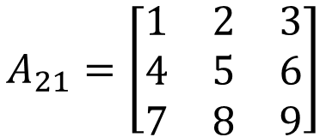
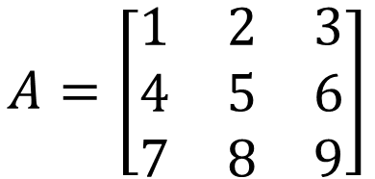



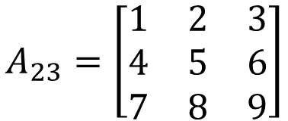
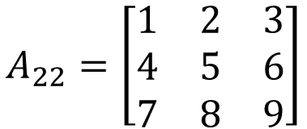
3 x 3 matrix
$$c_{ij}={\left(−1\right)}^{i+j}detA_{ij}$$
$$A=\left[\begin{matrix}1 & 2 & 3 \\ 4 & 5 & 6 \\ 7 & 8 & 9\end{matrix}\right]$$
Pick row 2
$$detA=a_{21}c_{21}+a_{22}c_{22}+a_{23}c_{23}$$
4
5
6
$${\left(−1\right)}^{2+1}detA_{21}$$
$${\left(−1\right)}^{2+2}detA_{22}$$
$${\left(−1\right)}^{2+3}detA_{23}$$
$$A_{21}=\left[\begin{matrix}1 & 2 & 3 \\ 4 & 5 & 6 \\ 7 & 8 & 9\end{matrix}\right]$$
$$A_{22}=\left[\begin{matrix}1 & 2 & 3 \\ 4 & 5 & 6 \\ 7 & 8 & 9\end{matrix}\right]$$
$$A_{23}=\left[\begin{matrix}1 & 2 & 3 \\ 4 & 5 & 6 \\ 7 & 8 & 9\end{matrix}\right]$$

Slide 11

Example
Given tridiagonal n x n matrix A
$$A=\left[\begin{matrix}\begin{matrix}\begin{matrix}1 & 1 \\ 1 & 1\end{matrix} & \begin{matrix}0 & ⋯ \\ 1 & ⋯\end{matrix} \\ \begin{matrix}0 & 1 \\ ⋮ & ⋮\end{matrix} & \begin{matrix}1 & ⋯ \\ ⋮ & ⋱\end{matrix}\end{matrix} & \begin{matrix}\begin{matrix}⋯ & 0 \\ ⋯ & 0\end{matrix} & \begin{matrix}0 & 0 \\ 0 & 0\end{matrix} \\ \begin{matrix}⋯ & 0 \\ ⋱ & ⋮\end{matrix} & \begin{matrix}0 & 0 \\ ⋮ & ⋮\end{matrix}\end{matrix} \\ \begin{matrix}\begin{matrix}⋮ & ⋮ \\ 0 & 0\end{matrix} & \begin{matrix}⋮ & ⋱ \\ 0 & ⋯\end{matrix} \\ \begin{matrix}0 & 0 \\ 0 & 0\end{matrix} & \begin{matrix}0 & ⋯ \\ 0 & ⋯\end{matrix}\end{matrix} & \begin{matrix}\begin{matrix}⋱ & ⋮ \\ ⋯ & 1\end{matrix} & \begin{matrix}⋮ & ⋮ \\ 1 & 0\end{matrix} \\ \begin{matrix}⋯ & 1 \\ ⋯ & 0\end{matrix} & \begin{matrix}1 & 1 \\ 1 & 1\end{matrix}\end{matrix}\end{matrix}\right]$$
Find detA when n = 999

Slide 12
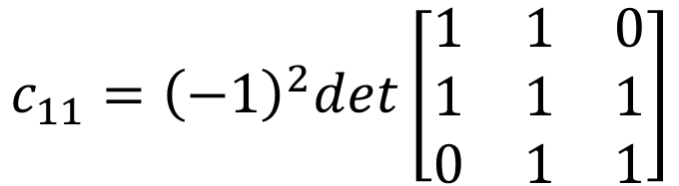



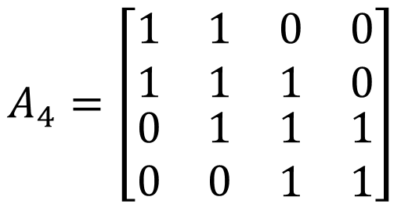
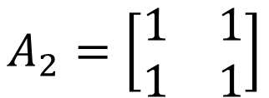

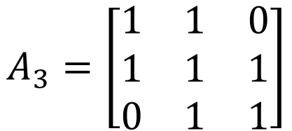
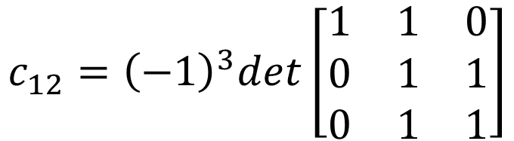
$$detA_{4}$$
$$A_{2}=\left[\begin{matrix}1 & 1 \\ 1 & 1\end{matrix}\right]$$
$$=a_{11}c_{11}+a_{12}c_{12}+a_{13}c_{13}+a_{14}c_{14}$$
1
1
0
0
$$A_{3}=\left[\begin{matrix}1 & 1 & 0 \\ 1 & 1 & 1 \\ 0 & 1 & 1\end{matrix}\right]$$
$$c_{11}={\left(−1\right)}^{2}det\left[\begin{matrix}1 & 1 & 0 \\ 1 & 1 & 1 \\ 0 & 1 & 1\end{matrix}\right]$$
$$A_{4}=\left[\begin{matrix}\begin{matrix}1 & 1 \\ 1 & 1\end{matrix} & \begin{matrix}0 & 0 \\ 1 & 0\end{matrix} \\ \begin{matrix}0 & 1 \\ 0 & 0\end{matrix} & \begin{matrix}1 & 1 \\ 1 & 1\end{matrix}\end{matrix}\right]$$
$$=det\left(A_{3}\right)$$
$$c_{12}={\left(−1\right)}^{3}det\left[\begin{matrix}1 & 1 & 0 \\ 0 & 1 & 1 \\ 0 & 1 & 1\end{matrix}\right]$$
$$=a_{11}c_{11}+a_{12}c_{12}+a_{13}c_{13}$$
$$=−det\left(A_{2}\right)$$
1
1
0
$$=det\left(A_{2}\right)$$

Slide 13









Example
$$det\left(A_{4}\right)=det\left(A_{3}\right)−det\left(A_{2}\right)$$
$$det\left(A_{n}\right)=det\left(A_{n−1}\right)−det\left(A_{n−2}\right)$$
$$det\left(A_{1}\right)=1$$
$$det\left(A_{2}\right)=0$$
$$det\left(A_{3}\right)=−1$$
$$det\left(A_{4}\right)=−1$$
$$det\left(A_{5}\right)=0$$
$$det\left(A_{6}\right)=1$$
$$det\left(A_{7}\right)=1$$
$$det\left(A_{8}\right)=0$$
$$……$$

Slide 14
Properties of Determinants
“Volume” in high dimensions (?)
Notes:
History: may be we can mention the history of determinant in the future
Ref:
http://www.askamathematician.com/2013/05/q-why-are-determinants-defined-the-weird-way-they-are/

Slide 15
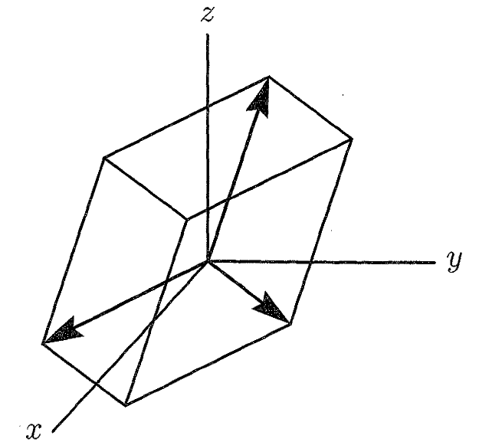

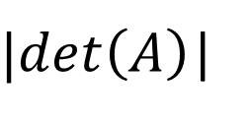




Determinants in High School
2 X 2
$$A=\left[\begin{matrix}a_{1} & a_{2} & a_{3} \\ a_{4} & a_{5} & a_{6} \\ a_{7} & a_{8} & a_{9}\end{matrix}\right]$$
3 x 3
$$A=\left[\begin{matrix}a & b \\ c & d\end{matrix}\right]$$
$$\left(a_{7},a_{8},a_{9}\right)$$
$|det\left(A\right)$|
絕對值!
(c,d)
V
(a,b)
$$\left(a_{1},a_{2},a_{3}\right)$$
$$\left(a_{4},a_{5},a_{6}\right)$$
Notes:
det(A) = volumn of box
How about A=I
How about A=Q (orthogonal matrix)
Draw a figure

Slide 16
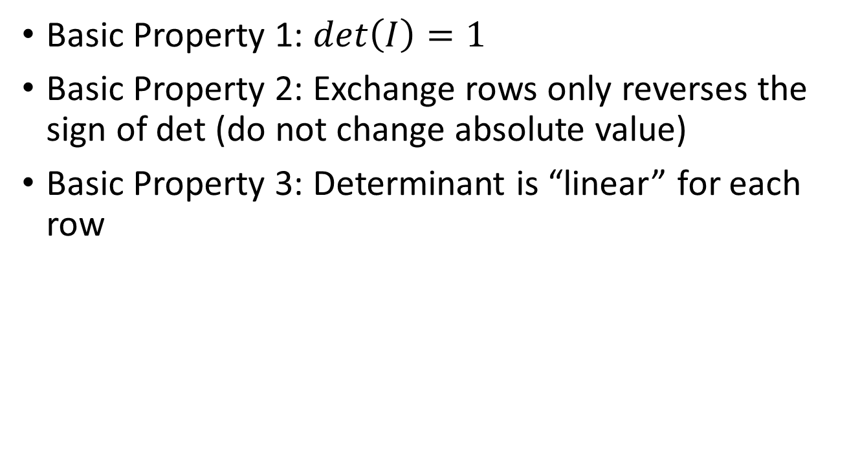
Three Basic Properties
Basic Property 1: $det\left(I\right)=1$
Basic Property 2: Exchange rows only reverses the sign of det (do not change absolute value)
Basic Property 3: Determinant is “linear” for each row
Area in 2d and Volume in 3d have the above properties
Can we say determinant is the “Volume” also in high dimension?
Notes:
Cofactor Expansion之所以这么复杂，也是这样推出来的，也就是说我们先定义了这些性质，然后推导出一个数值，叫determinant。
之所以我们把determinant可以看做是“体积”，也是因为体积也满足这些条件。
There is something called determinant. When determinant =0, the matrix is not invertible.

Slide 17





Three Basic Properties
Basic Property 1:
$det\left(I\right)=1$
正方形
面積為 1
正立方體
體積為 1
$$I_{3}=\left[\begin{matrix}1 & 0 & 0 \\ 0 & 1 & 0 \\ 0 & 0 & 1\end{matrix}\right]$$
$$I_{2}=\left[\begin{matrix}1 & 0 \\ 0 & 1\end{matrix}\right]$$
$$det\left(I_{2}\right)=1$$
$$det\left(I_{3}\right)=1$$

Slide 18
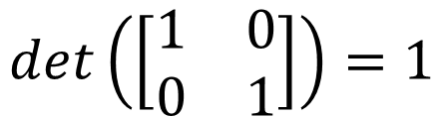

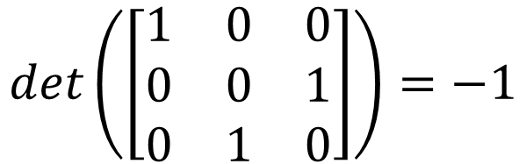

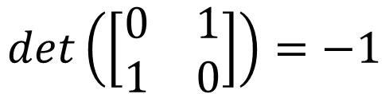
Three Basic Properties
Basic Property 2:
Exchanging rows only reverses the sign of det
$$det\left(\left[\begin{matrix}1 & 0 & 0 \\ 0 & 1 & 0 \\ 0 & 0 & 1\end{matrix}\right]\right)=1$$
$$det\left(\left[\begin{matrix}1 & 0 \\ 0 & 1\end{matrix}\right]\right)=1$$
$$det\left(\left[\begin{matrix}1 & 0 & 0 \\ 0 & 0 & 1 \\ 0 & 1 & 0\end{matrix}\right]\right)=−1$$
$$det\left(\left[\begin{matrix}0 & 1 \\ 1 & 0\end{matrix}\right]\right)=−1$$
$$det\left(\left[\begin{matrix}0 & 1 & 0 \\ 0 & 0 & 1 \\ 1 & 0 & 0\end{matrix}\right]\right)=1$$
Notes:
Check by geometry?

Slide 19


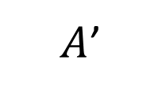



Three Basic Properties
Basic Property 2:
Exchanging rows only reverses the sign of det
If a matrix A has 2 equal rows
$$det\left(A\right)=0$$
exchange two rows
$$A$$
$A$’
$$det\left(A\right)=K$$
$$=$$
$$det\left(A′\right)=−K$$
Exchanging the two equal rows yields the same matrix
Notes:
如果把determinant看作体积的话，如果两条边是一样的（vector），也就是他们重合了，这个体积就是0了。

Slide 20
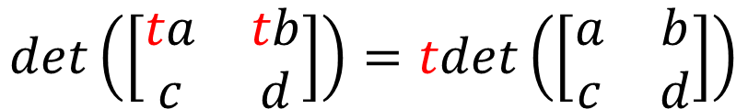
Three Basic Properties
Basic Property 3:
Determinant is “linear” for each row
3-a
$$det\left(\left[\begin{matrix}ta & tb \\ c & d\end{matrix}\right]\right)=tdet\left(\left[\begin{matrix}a & b \\ c & d\end{matrix}\right]\right)$$
(c,d)
(c,d)
V
V
V
(a,b)
(2a,2b)

Slide 21
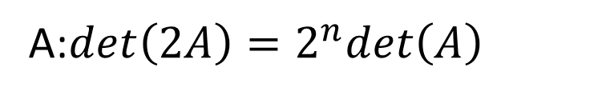
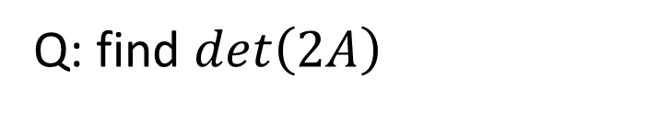
Three Basic Properties
Basic Property 3:
Determinant is “linear” for each row
3-a
$$det\left(\left[\begin{matrix}ta & tb \\ c & d\end{matrix}\right]\right)=tdet\left(\left[\begin{matrix}a & b \\ c & d\end{matrix}\right]\right)$$
Q: find $det\left(2A\right)$
If A is n x n ……
A:$det\left(2A\right)=2^{n}det\left(A\right)$
Notes:
每条边都乘了2倍，所以一共多乘了n次2，就是2的n次方

Slide 22
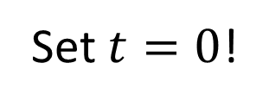

Three Basic Properties
Basic Property 3:
Determinant is “linear” for each row
3-a
$$det\left(\left[\begin{matrix}ta & tb \\ c & d\end{matrix}\right]\right)=tdet\left(\left[\begin{matrix}a & b \\ c & d\end{matrix}\right]\right)$$
A row of zeros
$$det\left(A\right)=0$$
Set $t=0$!
A row of zeros
“volume” is zero

Slide 23
Three Basic Properties
Basic Property 3:
Determinant is “linear” for each row
3-b
$$det\left(\left[\begin{matrix}a+a′ & b+b′ \\ c & d\end{matrix}\right]\right)=det\left(\left[\begin{matrix}a & b \\ c & d\end{matrix}\right]\right)+det\left(\left[\begin{matrix}a′ & b′ \\ c & d\end{matrix}\right]\right)$$
(c,d)
(c,d)
(a+a’,b+b’)
(a+a’,b+b’)
(a,b)
(a,b)
Notes:
Determinant的对row是线性的，他本身并不线性。
det(A) + det(B) ≠ det(A+B)

Slide 24
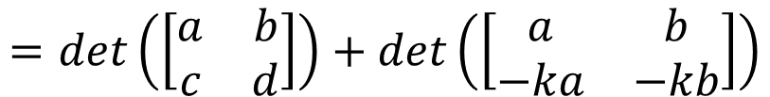
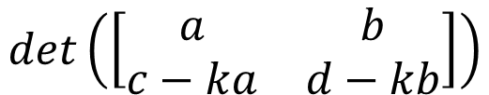
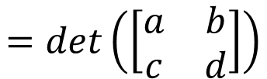
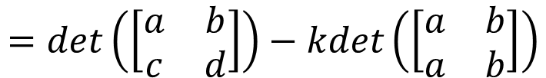
Three Basic Properties
Basic Property 3:
Determinant is “linear” for each row
Subtract k x row i from row j (elementary row operation)
Determinant doesn’t change
$$det\left(\left[\begin{matrix}a & b \\ c−ka & d−kb\end{matrix}\right]\right)$$
3-b
$$=det\left(\left[\begin{matrix}a & b \\ c & d\end{matrix}\right]\right)+det\left(\left[\begin{matrix}a & b \\ −ka & −kb\end{matrix}\right]\right)$$
3-a
$$=det\left(\left[\begin{matrix}a & b \\ c & d\end{matrix}\right]\right)−kdet\left(\left[\begin{matrix}a & b \\ a & b\end{matrix}\right]\right)$$
$$=det\left(\left[\begin{matrix}a & b \\ c & d\end{matrix}\right]\right)$$

Slide 25

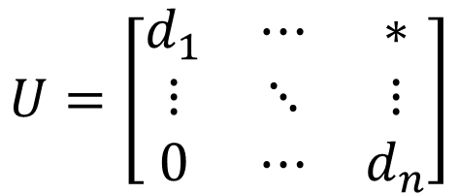
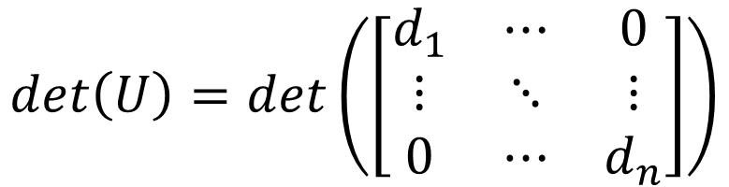
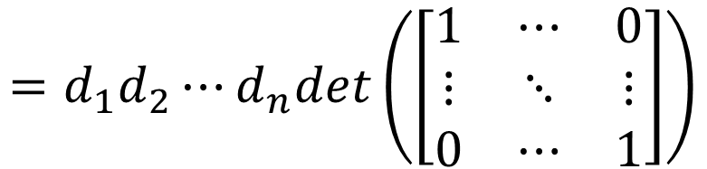
Determinants for Upper Triangular Matrix
$$U=\left[\begin{matrix}d_{1} & ⋯ & ∗ \\ ⋮ & ⋱ & ⋮ \\ 0 & ⋯ & d_{n}\end{matrix}\right]$$
Killing everything above
Does not change the det
$$det\left(U\right)=det\left(\left[\begin{matrix}d_{1} & ⋯ & 0 \\ ⋮ & ⋱ & ⋮ \\ 0 & ⋯ & d_{n}\end{matrix}\right]\right)$$
Property 1
$$=d_{1}d_{2}⋯d_{n}det\left(\left[\begin{matrix}1 & ⋯ & 0 \\ ⋮ & ⋱ & ⋮ \\ 0 & ⋯ & 1\end{matrix}\right]\right)$$
3-a
= 1
$$det\left(U\right)=d_{1}d_{2}⋯d_{n}$$
(Products of diagonal)

Slide 26







Determinants v.s. Invertible
A is invertible
det(A) ≠ 0
A
R
Elementary row operation
$$det\left(A\right)$$
$$det\left(R\right)$$
$$=±k_{1}k_{2}⋯det\left(A\right)$$
If A is invertible,
R is identity
Exchange:
Change sign
$$det\left(R\right)=1$$
$$det\left(A\right)≠0$$
Scaling:
Multiply k
If A is not invertible,
R has zero row
Add row:
nothing
$$det\left(A\right)=0$$
$$det\left(R\right)=0$$

Slide 27
Invertible
We collect one more properties for invertible!
Let A be an n x n matrix. A is invertible if and only if
The columns of A span R^{n}
For every b in R^{n}, the system Ax=b is consistent
The rank of A is n
The columns of A are linear independent
The only solution to Ax=0 is the zero vector
The nullity of A is zero
The reduced row echelon form of A is I_{n}
A is a product of elementary matrices
There exists an n x n matrix B such that BA = I_{n}
There exists an n x n matrix C such that AC = I_{n}
det(A) ≠ 0
onto
One-on-one
Notes:
When A is square, one side is sufficient.

Slide 28












Example
A is invertible
det(A) ≠ 0
$$A=\left[\begin{matrix}1 & −1 & 2 \\ −1 & 0 & c \\ 2 & 1 & 7\end{matrix}\right]$$
For what scalar c is the matrix not invertible?
det(A) = 0
$$detA=$$
$$1∙0∙7$$
$$+\left(−1\right)∙c∙2$$
$$+2∙\left(−1\right)∙1$$
$$−2∙0∙2$$
$$−\left(−1\right)∙\left(−1\right)∙7$$
$$−1∙c∙1$$
$$=0−2c−2−7−c$$
$$=−3c−9$$
not invertible
$$−3c−9=0$$
$$c=−3$$

Slide 29






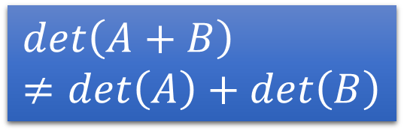
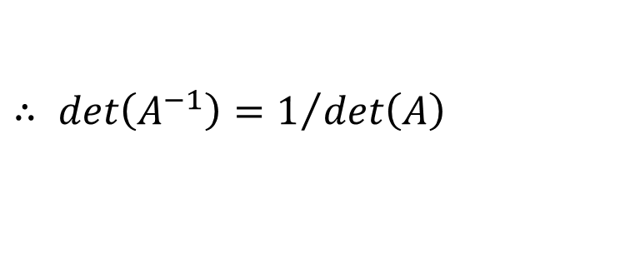

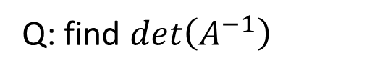
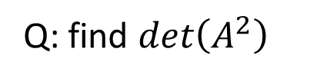
More Properties of Determinants
$$det\left(A+B\right)≠det\left(A\right)+det\left(B\right)$$
$det\left(AB\right)=det\left(A\right)det\left(B\right)$
$det\left(A^{T}\right)=det\left(A\right)$
Zero row → zero column
Same row → same column ……
Q: find $det\left(A^{−1}\right)$
$$∵A^{−1}A=I$$
$$=1$$
$$∴det\left(A^{−1}\right)det\left(A\right)=det\left(I\right)$$
$∴ det\left(A^{−1}\right)=1/{det\left(A\right)}$
Q: find $det\left(A^{2}\right)$
$$det\left(A^{2}\right)$$
$$=det\left(A\right)det\left(A\right)$$
$$={det\left(A\right)}^{2}$$
P212 - 215
Notes:
Column is “linear”

Slide 30
Cramer’s Rule
Notes:
for x=A⁻¹b

Slide 31
Formula for A⁻¹
$C=\left[\begin{matrix}c_{11} & ⋯ & c_{1n} \\ ⋮ & ⋱ & ⋮ \\ c_{n1} & ⋯ & c_{nn}\end{matrix}\right]$
$A^{−1}=\frac{1}{det\left(A\right)}C^{T}$
$det\left(A\right)$: scalar
$C$: cofactors of A ($C$ has the same size as A, so does $C^{T}$)
$C^{T}$ is adjugate of A (adj A, 伴隨矩陣)
$$C=\left[\begin{matrix}c_{11} & c_{12} \\ c_{21} & c_{22}\end{matrix}\right]$$
$$A=\left[\begin{matrix}a & b \\ c & d\end{matrix}\right]$$
$$A^{−1}$$
$$=\left[\begin{matrix}d & −c \\ −b & a\end{matrix}\right]$$
$$det\left(A\right)$$
$$=\frac{1}{ad−bc}\left[\begin{matrix}d & −b \\ −c & a\end{matrix}\right]$$
$$C^{T}$$
$$=\left[\begin{matrix}d & −b \\ −c & a\end{matrix}\right]$$
$$=ad−bc$$

Slide 32

Formula for A⁻¹
$$A^{−1}=\frac{1}{det\left(A\right)}C^{T}$$
$A=\left[\begin{matrix}a & b & c \\ d & e & f \\ g & h & i\end{matrix}\right], A^{−1}=$?
$$det\left(A\right)=aei+bfg+cdh−ceg−bdi−afh$$
$$+$$
$$\left|\begin{matrix}e & f \\ h & i\end{matrix}\right|$$
$$−$$
$$\left|\begin{matrix}d & f \\ g & i\end{matrix}\right|$$
$$+$$
$$\left|\begin{matrix}d & e \\ g & h\end{matrix}\right|$$
$$C=$$
$$−$$
$$\left|\begin{matrix}b & c \\ h & i\end{matrix}\right|$$
$$\left|\begin{matrix}a & c \\ g & i\end{matrix}\right|$$
$$\left|\begin{matrix}a & b \\ g & h\end{matrix}\right|$$
$$+$$
$$−$$
$$\left|\begin{matrix}b & c \\ e & f\end{matrix}\right|$$
$$\left|\begin{matrix}a & c \\ d & f\end{matrix}\right|$$
$$\left|\begin{matrix}a & b \\ d & e\end{matrix}\right|$$
$$+$$
$$−$$
$$+$$
Notes:
用手寫版吧

Slide 33
Formula for A⁻¹
$$A^{−1}=\frac{1}{det\left(A\right)}C^{T}$$
Proof: $AC^{T}=det\left(A\right)I_{n}$
$$\left[\begin{matrix}a_{11} & ⋯ & a_{1n} \\ ⋮ & ⋱ & ⋮ \\ a_{n1} & ⋯ & a_{nn}\end{matrix}\right]\left[\begin{matrix}c_{11} & ⋯ & c_{n1} \\ ⋮ & ⋱ & ⋮ \\ c_{1n} & ⋯ & c_{nn}\end{matrix}\right]=\left[\begin{matrix}det\left(A\right) & ⋯ & 0 \\ ⋮ & ⋱ & ⋮ \\ 0 & ⋯ & det\left(A\right)\end{matrix}\right]$$
transpose
Diagonal:
By definition of determinants
Not Diagonal:
(Exercise 82, P221)

Slide 34
Cramer’s Rule
$$A^{−1}=\frac{1}{det\left(A\right)}C^{T}$$
$$x_{1}=\frac{det\left(B_{1}\right)}{det\left(A\right)}$$
$B_{1}=$with column 1 replaced by b
$$Ax=b$$
$$x_{2}=\frac{det\left(B_{2}\right)}{det\left(A\right)}$$
$$x=A^{−1}b$$
n-1
Columns
of A
$$b$$
$$=\frac{1}{det\left(A\right)}C^{T}b$$
……
$$x_{j}=\frac{det\left(B_{j}\right)}{det\left(A\right)}$$
$B_{j}=$with column j replaced by b
Notes:
$$c_{11}b_{1}+c_{21}b_{2}+⋯$$

Slide 35
Appendix
Notes:
Ref:
http://www.askamathematician.com/2013/05/q-why-are-determinants-defined-the-weird-way-they-are/

Slide 36
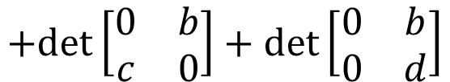

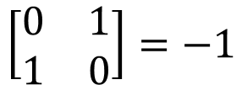
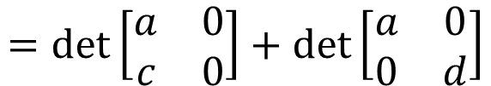








Formula from Three Properties
1
2
$$\left[\begin{matrix}1 & 0 \\ 0 & 1\end{matrix}\right]=1$$
$$\left[\begin{matrix}0 & 1 \\ 1 & 0\end{matrix}\right]=−1$$
$$det\left[\begin{matrix}a & b \\ c & d\end{matrix}\right]$$
$$=det\left[\begin{matrix}a & 0 \\ c & d\end{matrix}\right]$$
$$+det\left[\begin{matrix}0 & b \\ c & d\end{matrix}\right]$$
3-b
$$=det\left[\begin{matrix}a & 0 \\ c & 0\end{matrix}\right]+det\left[\begin{matrix}a & 0 \\ 0 & d\end{matrix}\right]$$
$$+det\left[\begin{matrix}0 & b \\ c & 0\end{matrix}\right]+det\left[\begin{matrix}0 & b \\ 0 & d\end{matrix}\right]$$
3-b
3-a
3-a
3-a
3-a
$$=0$$
$$=ad$$
$$=−bc$$
$$=0$$
$$=ad−bc$$

Slide 37










Finally, we get 3 x 3 x 3 matrices
$$det\left[\begin{matrix}a_{11} & a_{12} & a_{13} \\ a_{21} & a_{22} & a_{23} \\ a_{31} & a_{32} & a_{33}\end{matrix}\right]$$
Most of them have zero determinants
$$=det\left[\begin{matrix}a_{11} & 0 & 0 \\ a_{21} & a_{22} & a_{23} \\ a_{31} & a_{32} & a_{33}\end{matrix}\right]$$
$$+det\left[\begin{matrix}0 & a_{12} & 0 \\ a_{21} & a_{22} & a_{23} \\ a_{31} & a_{32} & a_{33}\end{matrix}\right]$$
$$+det\left[\begin{matrix}0 & 0 & a_{13} \\ a_{21} & a_{22} & a_{23} \\ a_{31} & a_{32} & a_{33}\end{matrix}\right]$$
$$=det\left[\begin{matrix}a_{11} & 0 & 0 \\ a_{21} & 0 & 0 \\ a_{31} & a_{32} & a_{33}\end{matrix}\right]$$
$$+det\left[\begin{matrix}a_{11} & 0 & 0 \\ 0 & a_{22} & 0 \\ a_{31} & a_{32} & a_{33}\end{matrix}\right]$$
$$+det\left[\begin{matrix}a_{11} & 0 & 0 \\ 0 & 0 & a_{23} \\ a_{31} & a_{32} & a_{33}\end{matrix}\right]$$
$$=det\left[\begin{matrix}a_{11} & 0 & 0 \\ a_{21} & 0 & 0 \\ a_{31} & 0 & 0\end{matrix}\right]$$
$$+det\left[\begin{matrix}a_{11} & 0 & 0 \\ a_{21} & 0 & 0 \\ 0 & a_{32} & 0\end{matrix}\right]$$
$$+det\left[\begin{matrix}a_{11} & 0 & 0 \\ a_{21} & 0 & 0 \\ 0 & 0 & a_{33}\end{matrix}\right]$$

Slide 38












$$det\left[\begin{matrix}a_{11} & a_{12} & a_{13} \\ a_{21} & a_{22} & a_{23} \\ a_{31} & a_{32} & a_{33}\end{matrix}\right]$$
3! matrices have non-zero rows
$$=\left[\begin{matrix}a_{11} & 0 & 0 \\ 0 & a_{22} & 0 \\ 0 & 0 & a_{33}\end{matrix}\right]$$
$$+\left[\begin{matrix}a_{11} & 0 & 0 \\ 0 & 0 & a_{23} \\ 0 & a_{32} & 0\end{matrix}\right]$$
$$+ \left[\begin{matrix}0 & a_{12} & 0 \\ a_{21} & 0 & 0 \\ 0 & 0 & a_{33}\end{matrix}\right]$$
$$a_{11}a_{22}a_{33}$$
$$−a_{11}a_{23}a_{32}$$
$$−a_{12}a_{21}a_{33}$$
$$+\left[\begin{matrix}0 & a_{12} & 0 \\ 0 & 0 & a_{23} \\ a_{31} & 0 & 0\end{matrix}\right]$$
$$+\left[\begin{matrix}0 & 0 & a_{13} \\ a_{21} & 0 & 0 \\ 0 & a_{32} & 0\end{matrix}\right]$$
$$+\left[\begin{matrix}0 & 0 & a_{13} \\ 0 & a_{22} & 0 \\ a_{31} & 0 & 0\end{matrix}\right]$$
$$a_{12}a_{23}a_{31}$$
$$a_{13}a_{21}a_{32}$$
$$−a_{13}a_{22}a_{31}$$
Pick an element at each row,
but they can not be in the same column.

Slide 39


Formula from Three Properties
Given an n x n matrix A
$$det\left(A\right)=\sum{n!terms }$$
Format of each term:
$$a_{1α}a_{2β}a_{3γ}⋯a_{nω}$$
Find an element in each row
permutation of 1,2, …, n
Notes:
$$±$$

Slide 40



Example
$$det\left(\left[\begin{matrix}\begin{matrix}0 & 0 \\ 0 & 1\end{matrix} & \begin{matrix}1 & 1 \\ 1 & 0\end{matrix} \\ \begin{matrix}1 & 1 \\ 1 & 0\end{matrix} & \begin{matrix}0 & 0 \\ 0 & 1\end{matrix}\end{matrix}\right]\right)$$
$$=det\left(\left[\begin{matrix}\begin{matrix}0 & 0 \\ 0 & 1\end{matrix} & \begin{matrix}1 & 0 \\ 0 & 0\end{matrix} \\ \begin{matrix}1 & 0 \\ 0 & 0\end{matrix} & \begin{matrix}0 & 0 \\ 0 & 1\end{matrix}\end{matrix}\right]\right)$$
$$+det\left(\left[\begin{matrix}\begin{matrix}0 & 0 \\ 0 & 0\end{matrix} & \begin{matrix}0 & 1 \\ 1 & 0\end{matrix} \\ \begin{matrix}0 & 1 \\ 1 & 0\end{matrix} & \begin{matrix}0 & 0 \\ 0 & 0\end{matrix}\end{matrix}\right]\right)$$
-1
+1

Slide 41





Formulas for Determinants
$$detA=\sum{n!terms }$$
Format of each term:
$$a_{1α}a_{2β}a_{3γ}⋯a_{nω}$$
$$detA=a_{11}c_{11}+a_{12}c_{12}+⋯+a_{1n}c_{1n}$$
All terms including $a_{11}$
All terms including $a_{12}$
All terms including $a_{1n}$

